Slide 1

The Best
Of
Baseball Awards
Analyzing data with SQL

Slide 2
In this project, we will be looking at a massive baseball database containing information about players, teams, managers, salaries, and just about anything you might want to know about baseball. This dataset contains data from 2019 all the way back to 1871. Letʼs see what interesting facts we can learn from this database!

Slide 3

For this project, I used the following tables related to each other from the entire database.

Slide 4

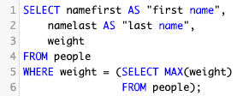
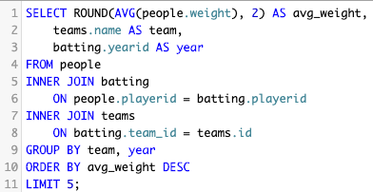
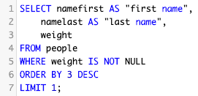
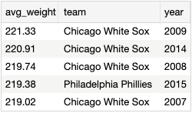

Heaviest Hitters
This award goes to the team with the highest average weight of its batters on a given year and to the heaviest player in history.
The heaviest team was Chicago White Sox
with average weight of 221.33lb in 2009
OR
The heaviest player title goes to:
Walter Young
320lb!

Slide 5
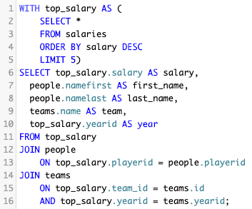
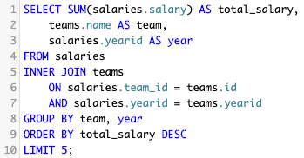
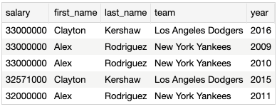
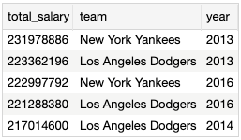
Biggest Spenders
This award goes to the team with the largest total salary of all players in a given year. Additional awards goes to the most expensive player.
Biggest Spenders Award goes to
New York Yankees!
They spent almost
232mln $ in 2013!
On the most expensive players rank we have a tie. So the title goes to both:
Alex Rodriguez who earned 33mln$ twice, playing for
New York Yankees in
2009 and 2010.
Clayton Kershaw who earned 33mln$, playing for
Los Angeles Dodgers in 2016.

Slide 6
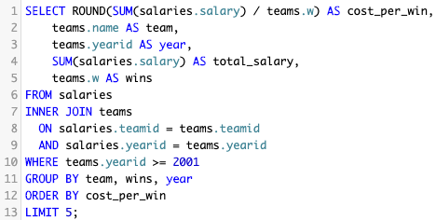

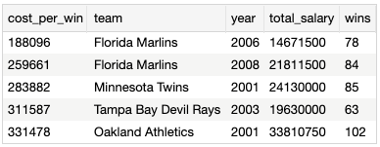
Most Bang For Their Buck In 21st Century
This award goes to the team that had the smallest "cost per win" in 21st century. Cost per win is determined by the total salary of the team divided by the number of wins in a given year.
And the winner is
…
Florida Marlins
They won 78 games in 2006 and spent less than 15 mln $ which gives them around 188k $ per win.

Slide 7

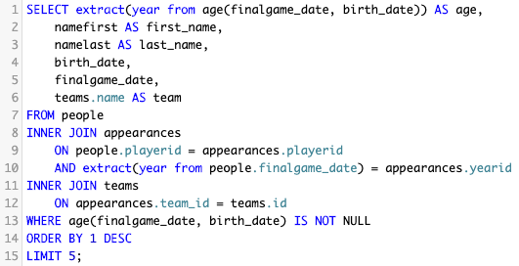
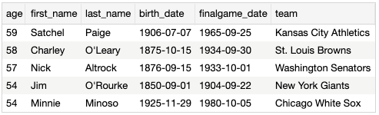
Granny Awards
This award goes to the oldest player in history.
And the winner is:
Satchel Paige
who played his last game for Kansas City Athletics
when he was 59 years old. Congratulations Grandpa!

Slide 8
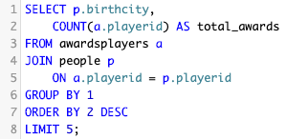
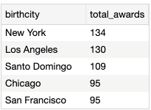

Awards Factory
This award goes to the city where the players with the most total rewards together were born.
Players who were born in New York got the highest number of awards, together they have 134 awards!
So "The Awards Factory" goes to New York!!!

Slide 9

Congratulations to all winners!
and
Thank you for checking
"The Best of Baseball Awards"!
Created by Dariusz Zielnik

